Slide 1

SESSION 01
Overview of the Different Modules of Microsoft Dynamics 365

Slide 2

“If you are not willing to learn, no one can help you.
If you are determined to learn, no one can stop you.”

Slide 3
Agenda
CRM Systems
Microsoft Dynamics 365 CRM
Modules of Dynamics 365 CRM
Sales
Marketing
Customer Service
Field Service
Project Service

Slide 4

CRM System

Slide 5
CRM Systems
Salesforce | NetSuite
HubSpot | Streak
Zoho Corporation | Microsoft Corporation
Pipedrive | Apptivo
SugarCRM | Nutshell
Insightly | Freshworks
Zendesk | ActiveCampaign
Capsule | Creatio
Really Simple Systems | ClickUp
Keap | Oracle CRM
Microsoft Dynamics 365 | BIGContacts
Mailchimp | Odoo

Slide 6
Microsoft Dynamics 365 Sales

Slide 7
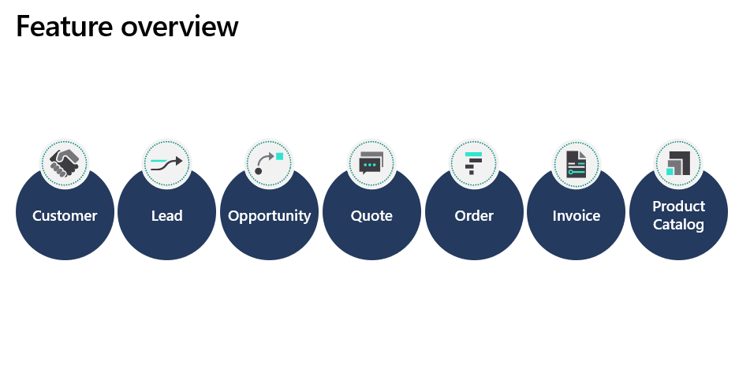

Slide 8
Sales process overview
Application designed for out-of-the-box use or configuration to match unique business processes
Business process flows streamline sales processes
Lead
Opportunity
Quote
Order
Invoice

Slide 9
Common terms
Account
Data model
Sales Hub
Activities
Table
Security Role
AI
Column
Sitemap
Business Process Flow
Lead
Solution
COLAC
Opportunity
Unified Interface
Contact
Product Catalog
User
Customer
Rows
View

Slide 10
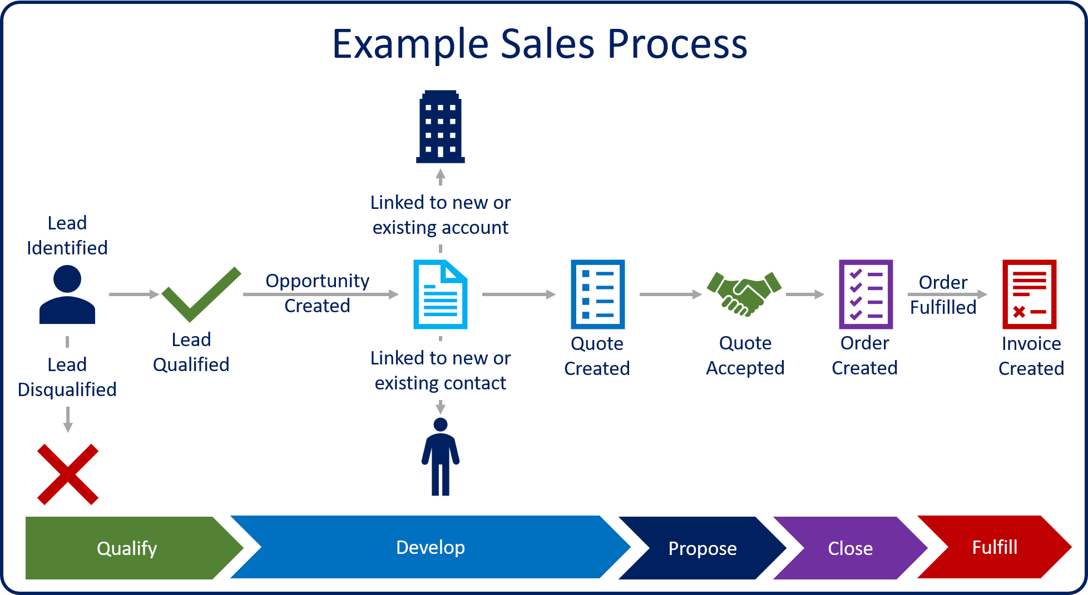
Work with leads in Dynamics 365 Sales

Slide 11
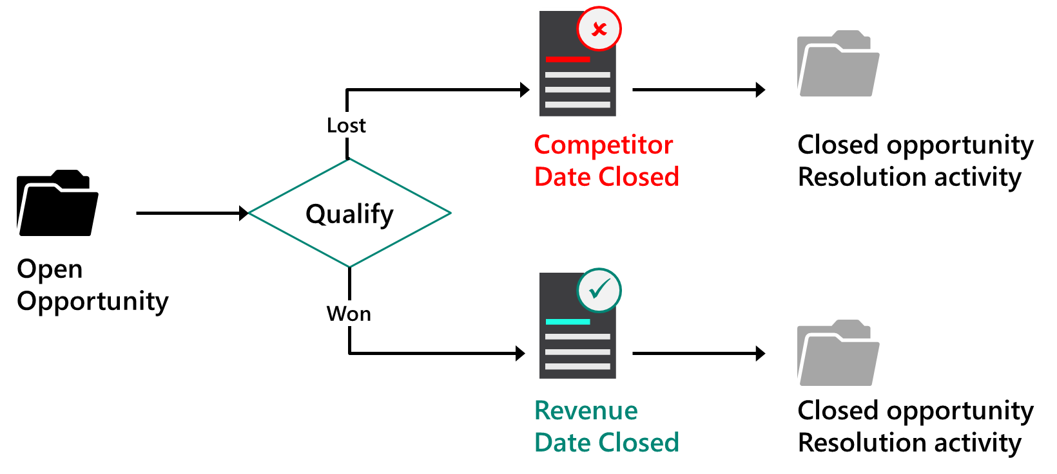
Opportunity management lifecycle

Slide 12
Product lifecycle
Create
Revise
Revert
Clone
Retire

Slide 13
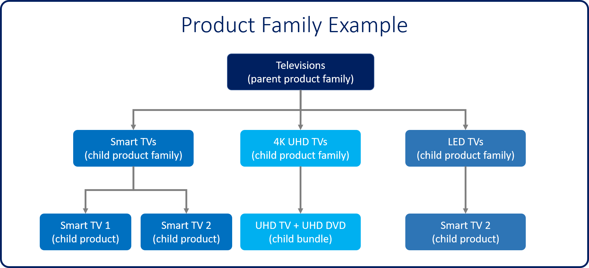
Product families

Slide 14
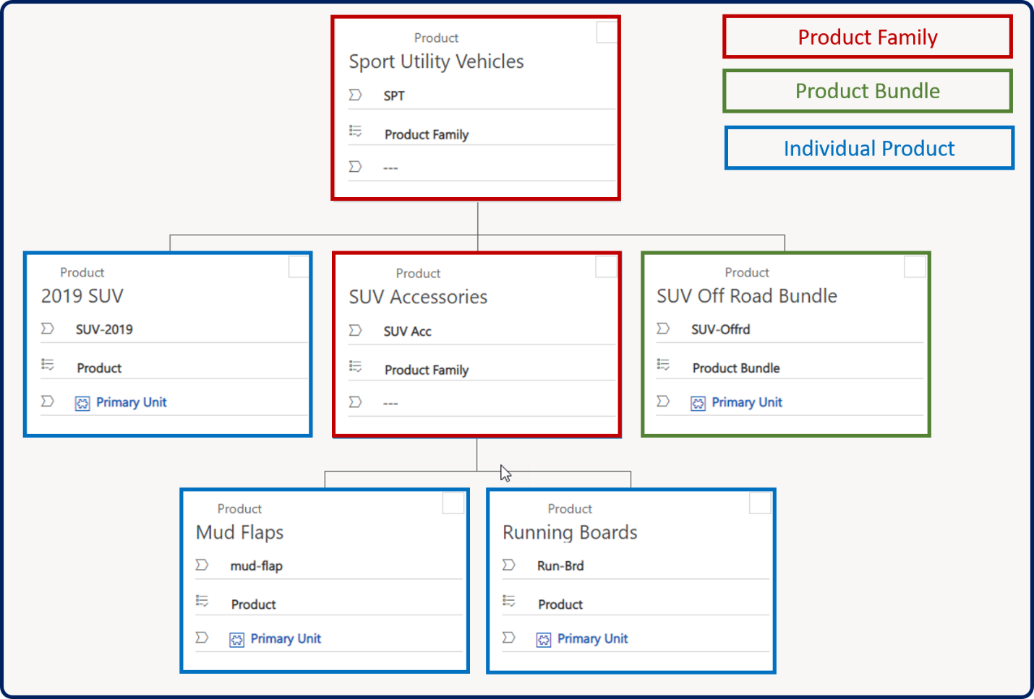
View a product hierarchy

Slide 15
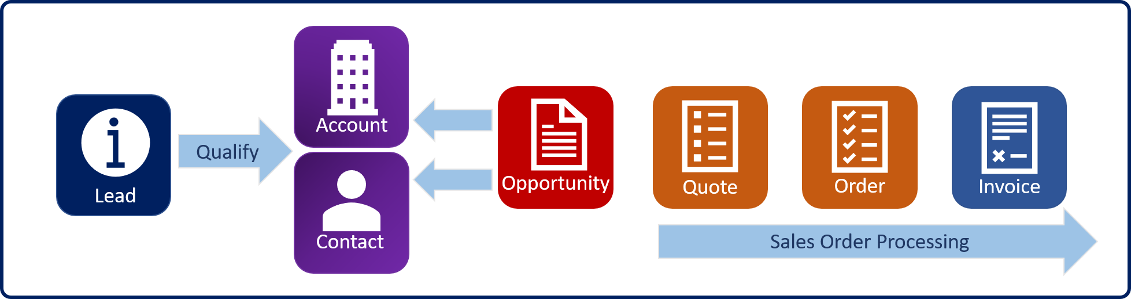
Sales order processing overview

Slide 16
Sales order processing overview
Quote: Formal offer for products and services
Order: Confirmed request for delivery of goods
Invoice: Order that has been billed to the customer
Opportunity
Quote
Order
Invoice

Slide 17
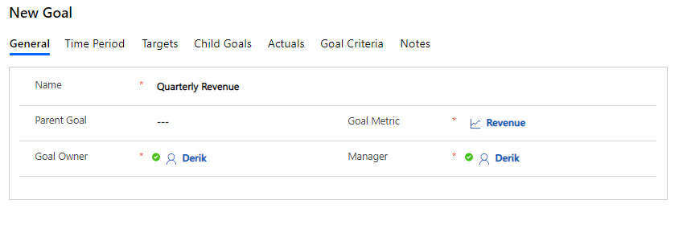
Goals
Goals can be a very important part to any organization, as they can be used for compensation, bonuses, or even advancement within an organization.

Slide 18
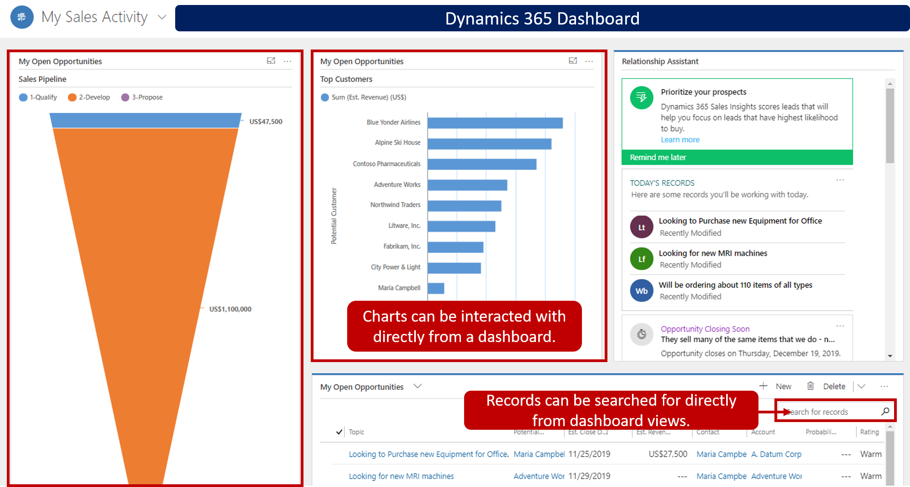
Analytical options

Slide 19
Microsoft Dynamics 365 Marketing

Slide 20
Dynamics 365 Marketing at a glance
Real-time marketing
Respond to customer actions in real time
Hyper-personalize your messaging
Connect with customers on the channels they use the most
Outbound marketing
Turn prospects into leads
Leverage the power of social media
Get customer feedback with Customer Voice surveys
Event planning
Manage all your event needs in one place
Meet your audience where they are
Continue the conversation with webinar participants

Slide 21
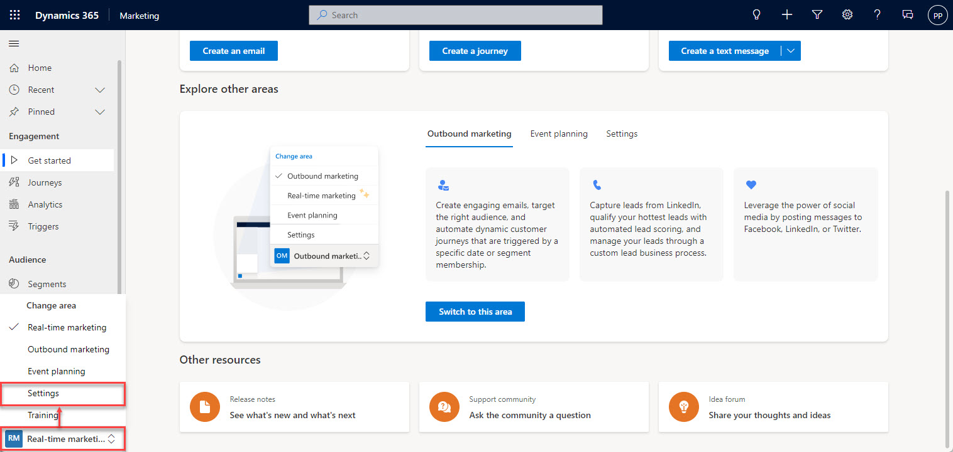
Access the Settings area in Dynamics 365 Marketing

Slide 22
Account-based marketing
Account-based journeys: Help generate account leads, trigger decisions at the account level, assign activities that are related to accounts
Account-based personalization of email content: Design content that displays information from, and reacts to, the account record
Account insights: Provide insights for each account record to provide results and KPIs that reflect interactions that are made by all contacts that belong to the account
Account-based leads and lead scoring: Generate leads that are related to accounts and score each of them to reflect activities of all the contacts that belong to an account

Slide 23
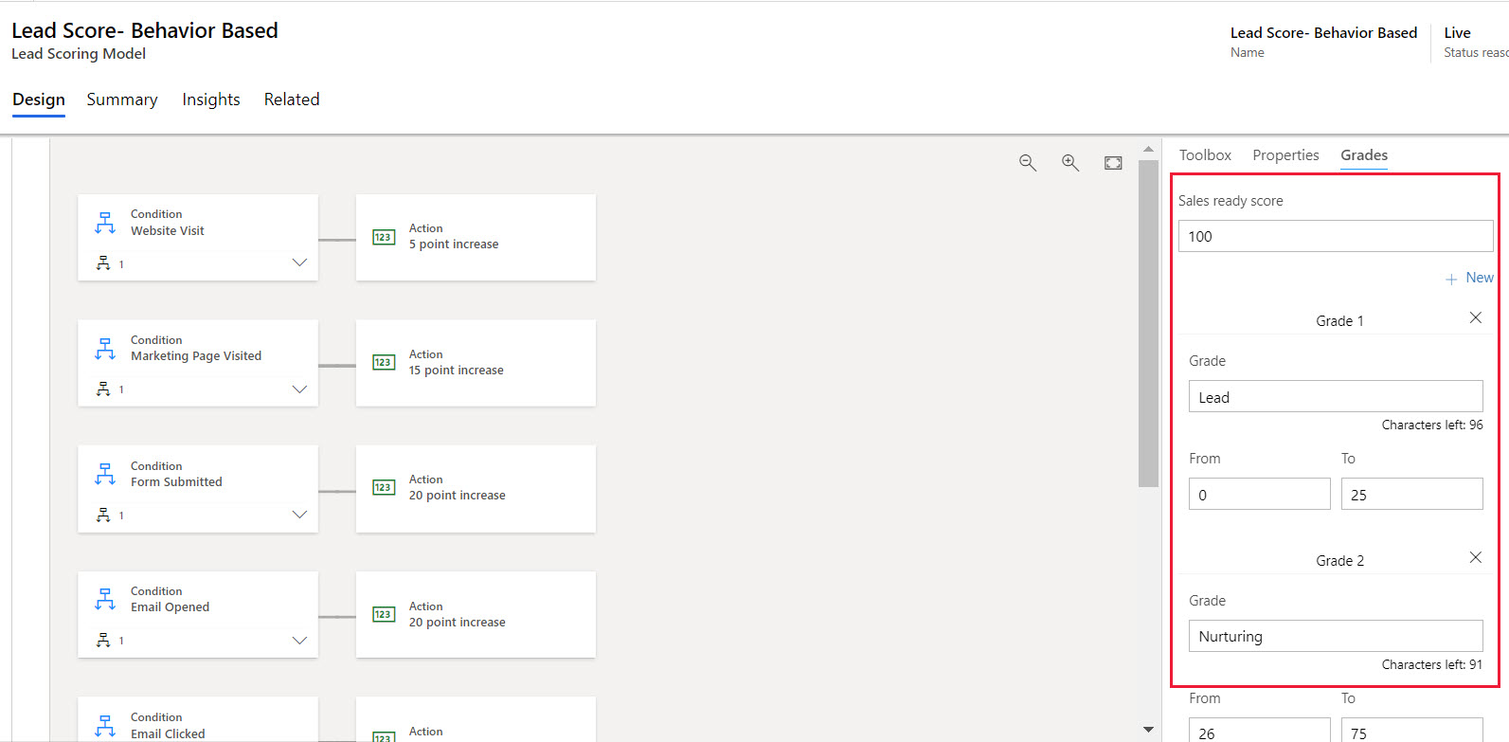
Lead scoring model

Slide 24
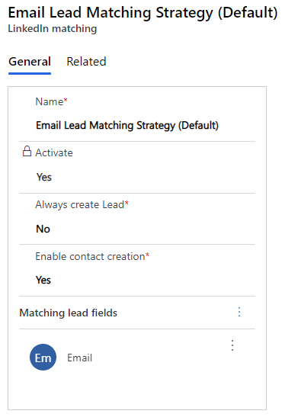
Capture leads generated on LinkedIn
Bring leads and lead information generated by LinkedIn Lead Gen into Dynamics 365.
Can either update an existing lead record or create a new lead
New LinkedIn leads will appear as “LinkedIn Form Submissions”
Can manage your lead matching strategy via Settings > Lead management > LinkedIn lead matching

Slide 25
Types of data
Behavioral data: Generated automatically in response to contact interactions (like opening an email, clicking a link in an email, submitting a form, or registering for an event)
Profile data: The information captured and stored on the entities that you regularly work with (like leads and accounts)

Slide 26
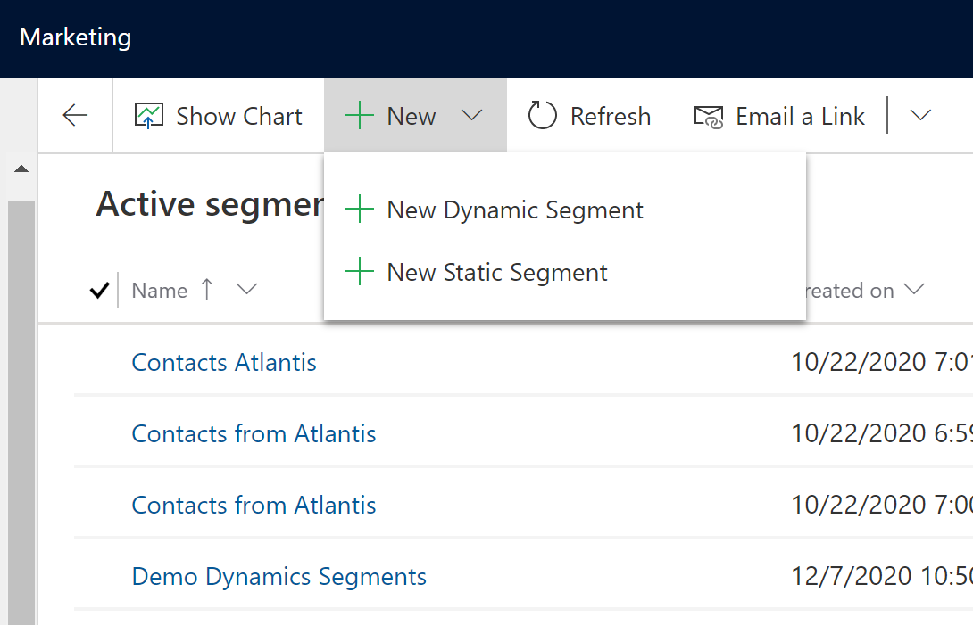
Types of segments
Static segment:
Selected on a per-contact basis rather than created logically based on field values. Marketers and salespeople might create and populate a static list based on private knowledge or offline interactions
Dynamic segment:
Set up by using logical expressions. Membership in dynamic segments changes constantly to reflect new or removed contacts and updated contact information

Slide 27
Design a marketing email
Create a marketing email from a template
Design the email including adding a logo and marketing page, updating text and button, and removing unnecessary elements
Preview the marketing email after it has been designed
Review and update the additional settings on the Summary tab
Check for errors, send a test email, and publish the marketing email

Slide 28
Introduction to customer journeys
Inbound journeys vs. outbound journeys
Use a “flow” to guide members of a selected segment through the process
Take contacts down unique paths based on their interaction

Slide 29
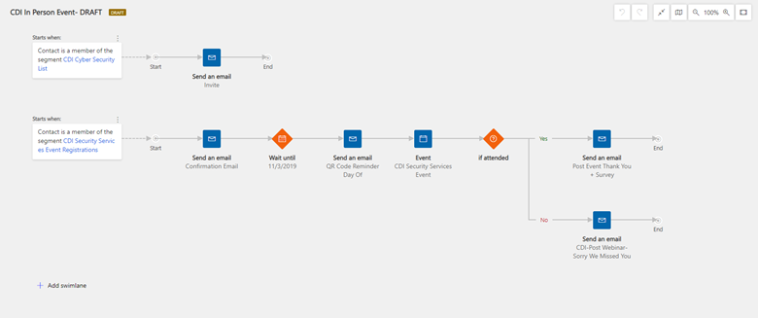
Set up customer journeys

Slide 30
Marketing on social media
Schedule and post messages on social media
Post from any social media account (authenticated by your admin in Marketing)
Marketing on LinkedIn
Import leads from LinkedIn Lead Gen Forms into Marketing
Design customer journey triggers reacing to Lead Gen Form submissions
Create LinkedIn Matched Audiences based on Marketing segments
Schedule and publish social posts to LinkedIn from Marketing

Slide 31
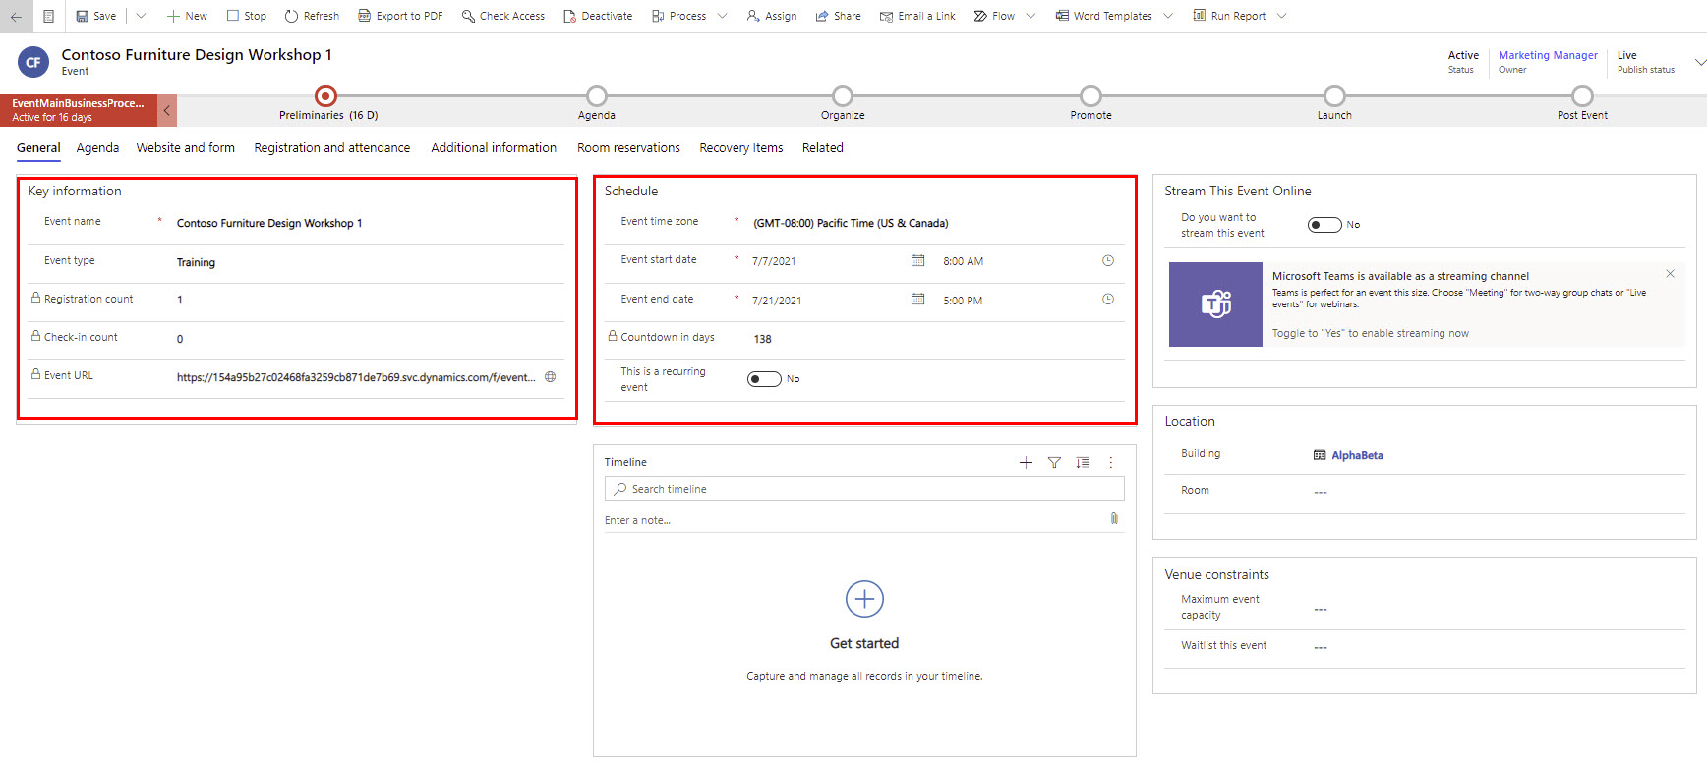
Event management
Create a root event record
Main tabs:
General | Agenda | Website and form | Registration and attendance | Additional information | Post event | Room reservations | Recovery items | Related
Create an event template

Slide 32
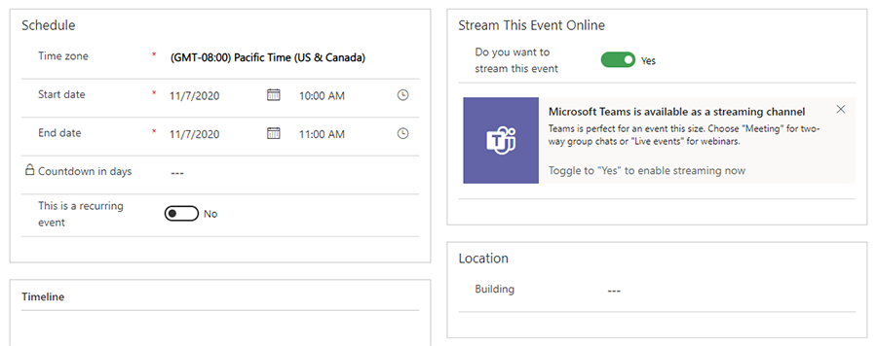
Microsoft Teams webinar event
Teams event functionality is now incorporated directly into Marketing, allowing you to host Teams live events for webinars and Teams meetings for interactive online meetings.

Slide 33
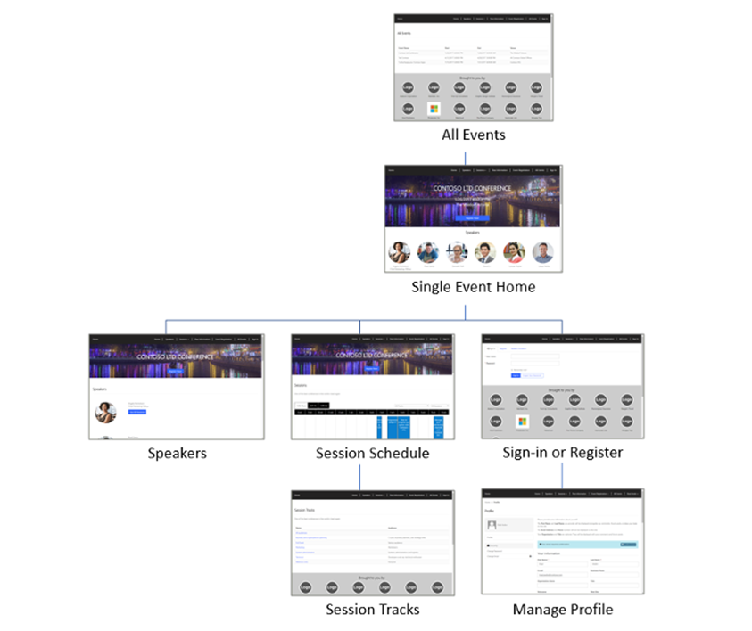
Event website
Online resource where people can read about your event, create an account, register, and other actions
Installed into Power Apps portals solution the first time Dynamics 365 Marketing is installed

Slide 34
Insights in Dynamics 365 Marketing
Open and use the insights form views
Filter insights by date range and usage
Move between insight categories

Slide 35
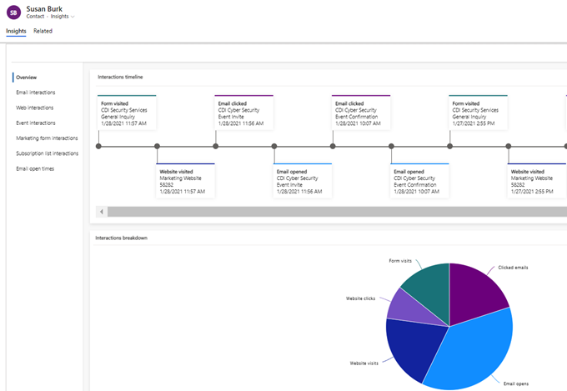
Contact insights
Find a complete history of how a selected contact has interacted with your marketing initiatives

Slide 36
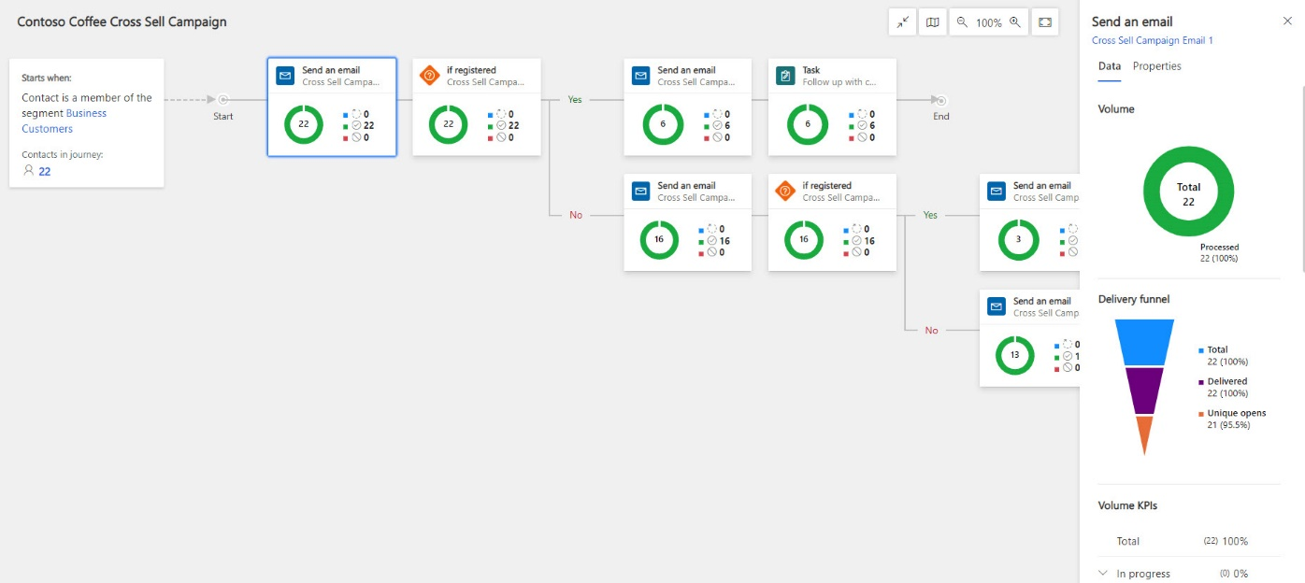
Customer journey insights
Monitor the performance campaigns by analyzing each activity and their respective KPIs

Slide 37
Microsoft Dynamics 365 Customer Engagement

Slide 38
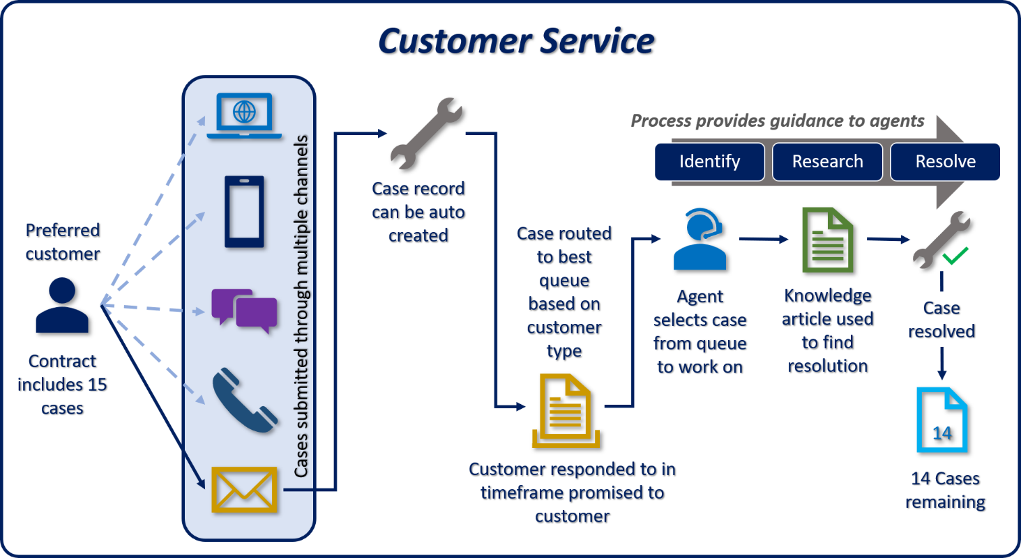
Dynamics 365 Customer Service

Slide 39
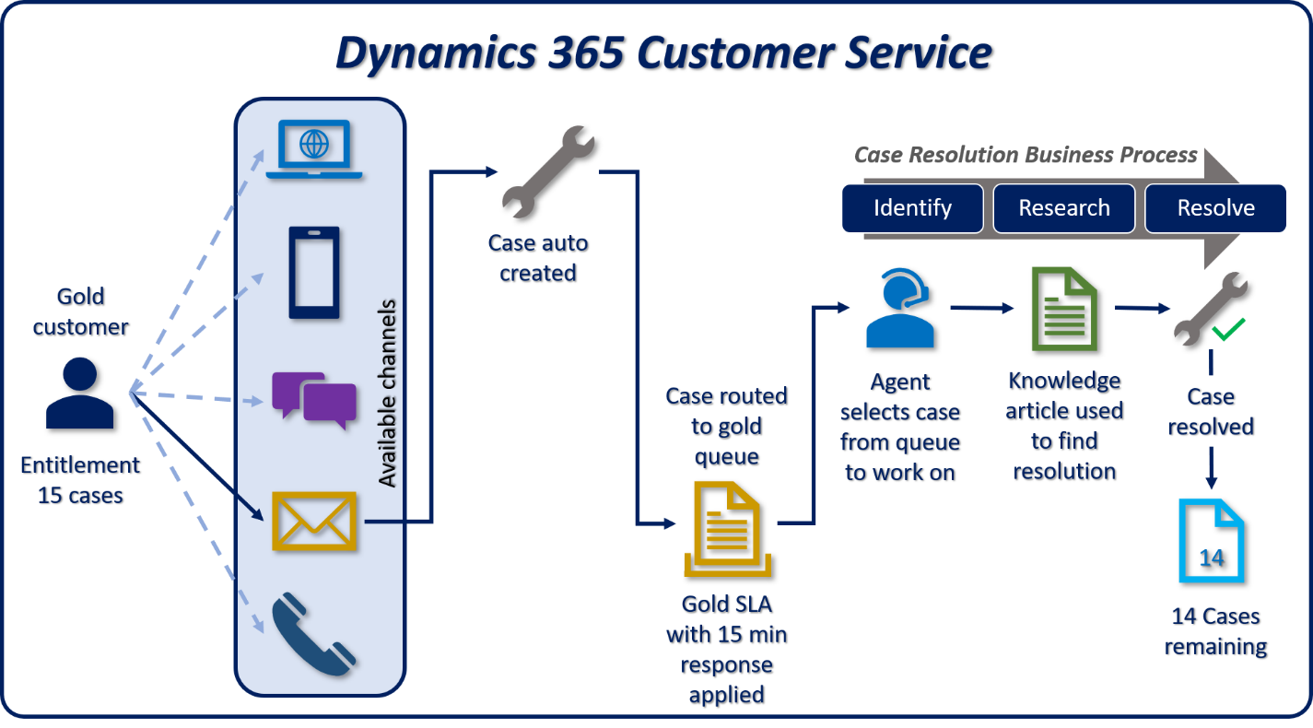
End-to-end case management solution

Slide 40
Customer Service core components
Types of records
Customer:
A company, organization, or person that service is performed for
Case:
Fundamental record type for Customer Service represents a single incident or service request
Activity:
Interactions between a business and its customers

Slide 41
Customer Service core components
Types of records
Entitlement:
The amount of support a customer is entitled to aka a support contract
Service Level Agreement:
The level of service that has been agreed with a customer
Knowledge Base:
Repository of knowledge articles to help resolve cases

Slide 42
Customer Service core components
Types of records
Queue:
A way to manage the workload for cases and activities
Assets:
Represents the item at a customer location that service is provided
Service:
Specifies the resources required to perform a service for a customer

Slide 43
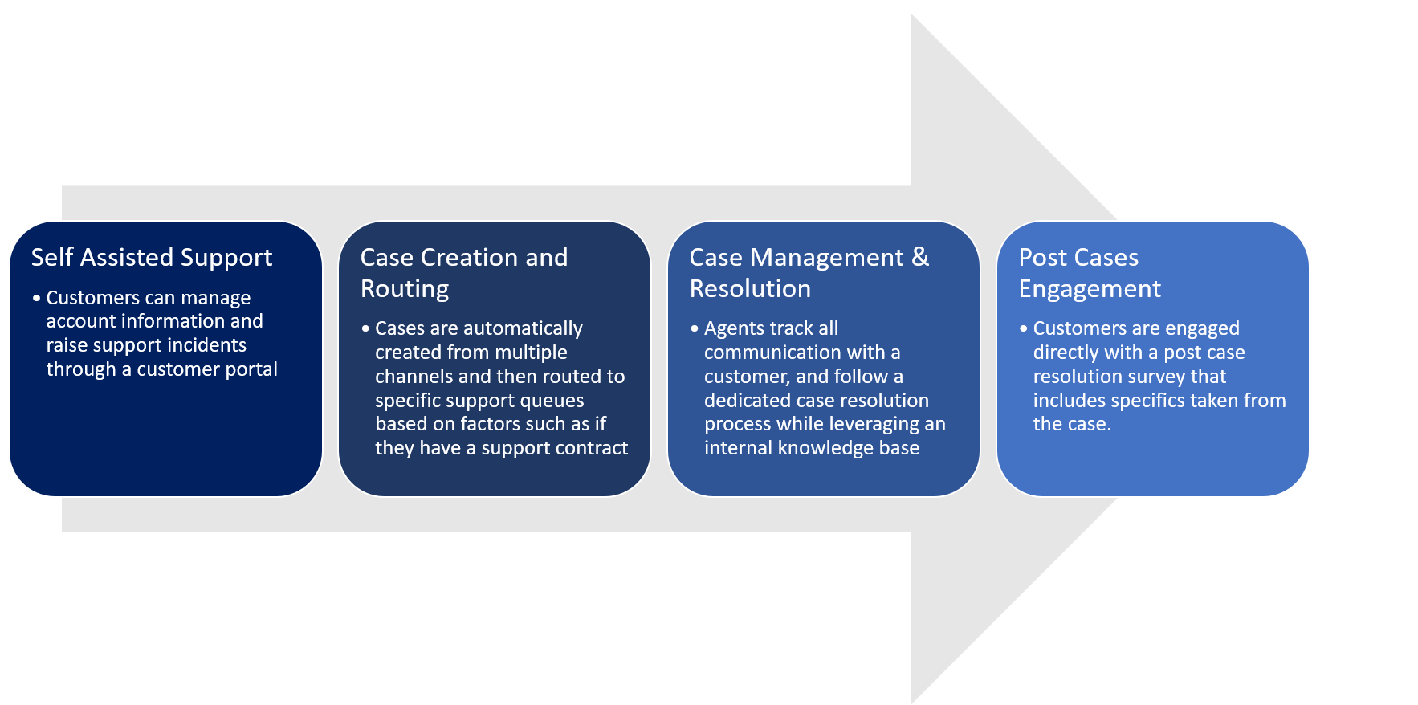
Typical Customer Support Journey

Slide 44
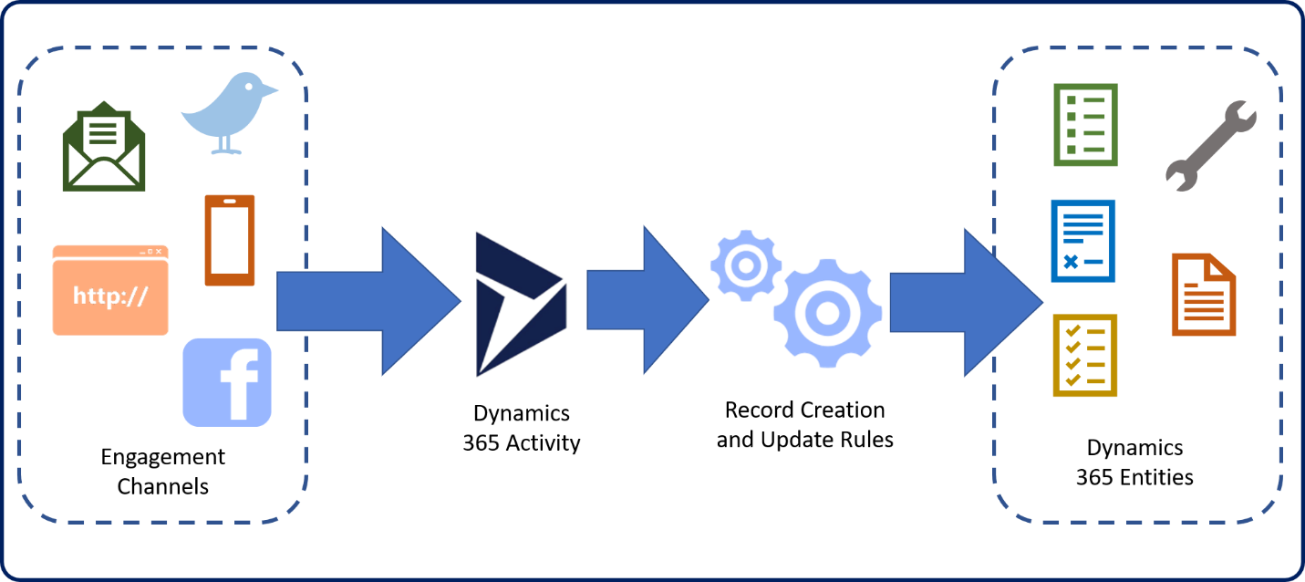
Case creation
Automatic case creation

Slide 45
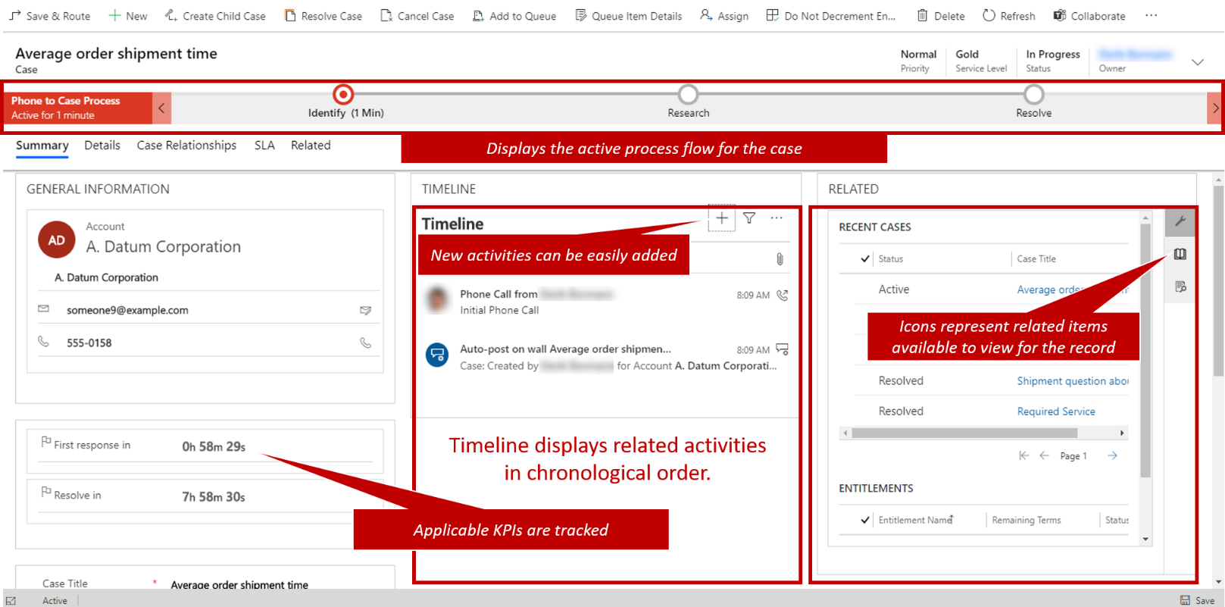
Case management
Tools to resolve cases

Slide 46
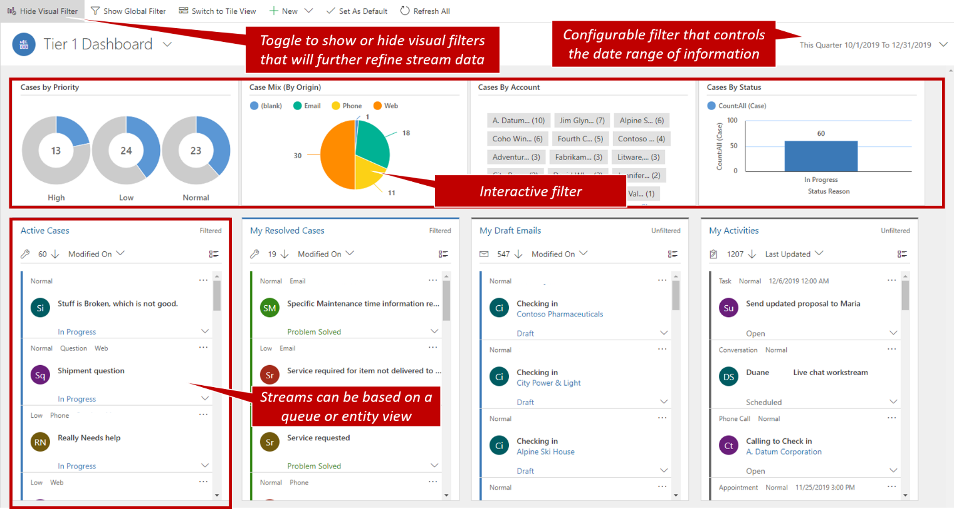
Case management
Case dashboards

Slide 47
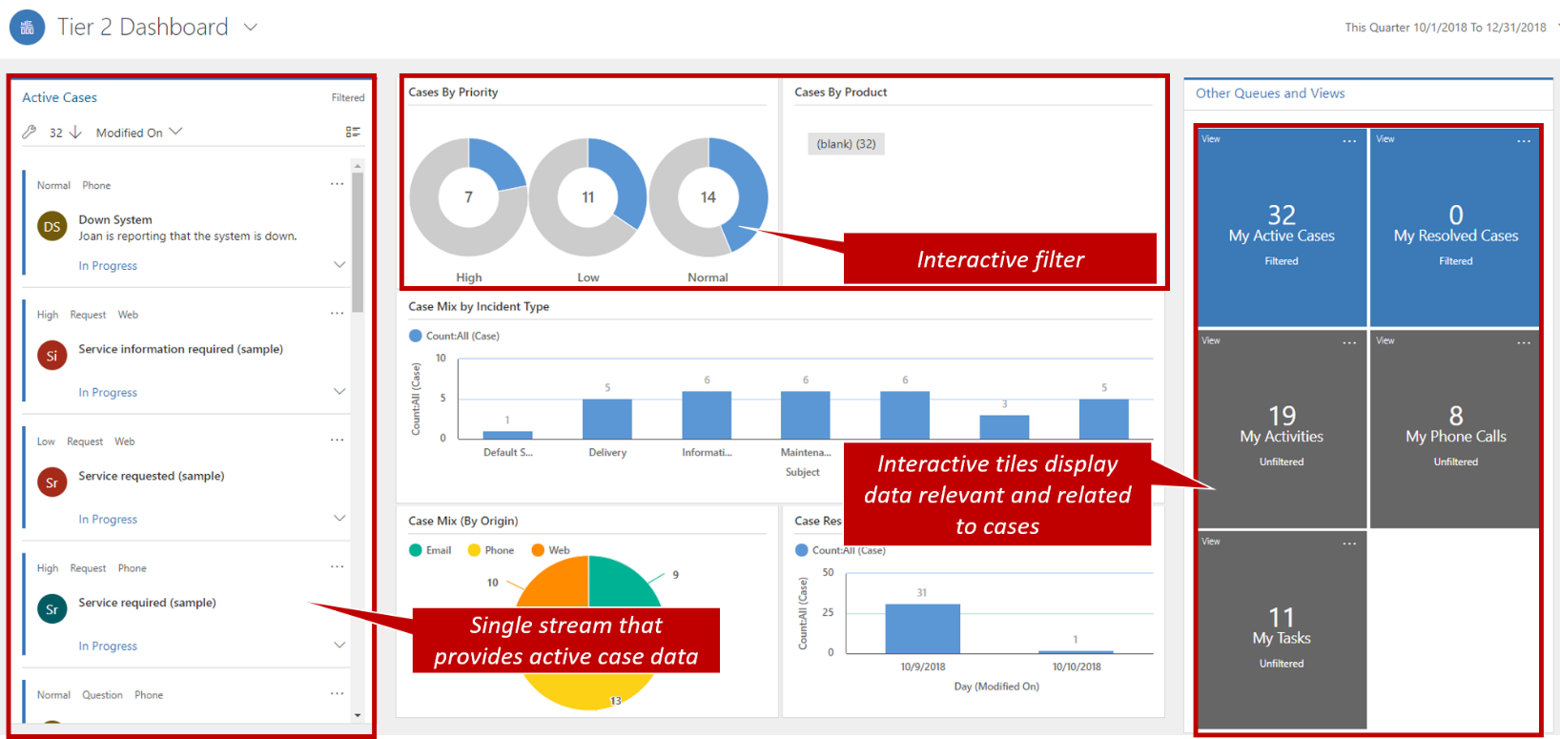
Case management
Case dashboards

Slide 48
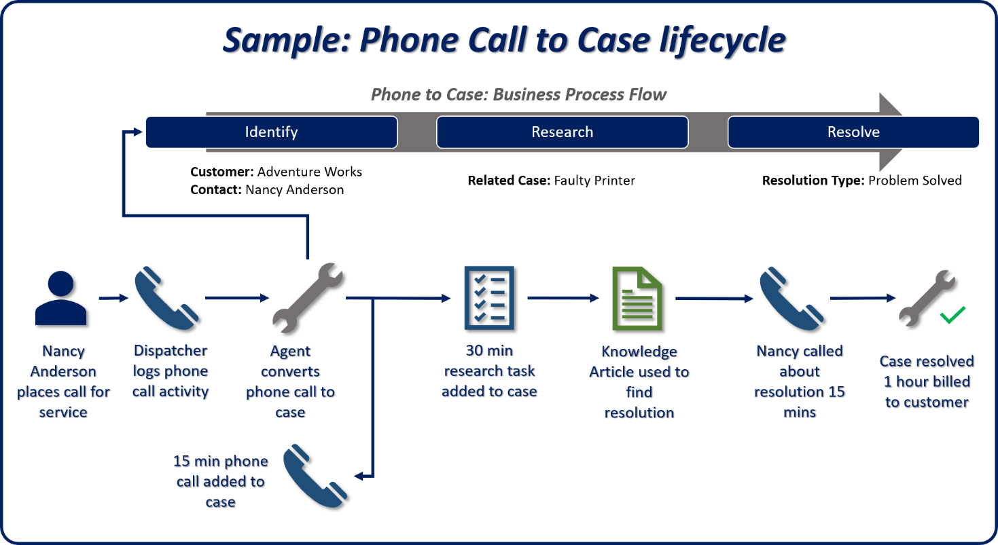
Case management
Business process flow

Slide 49
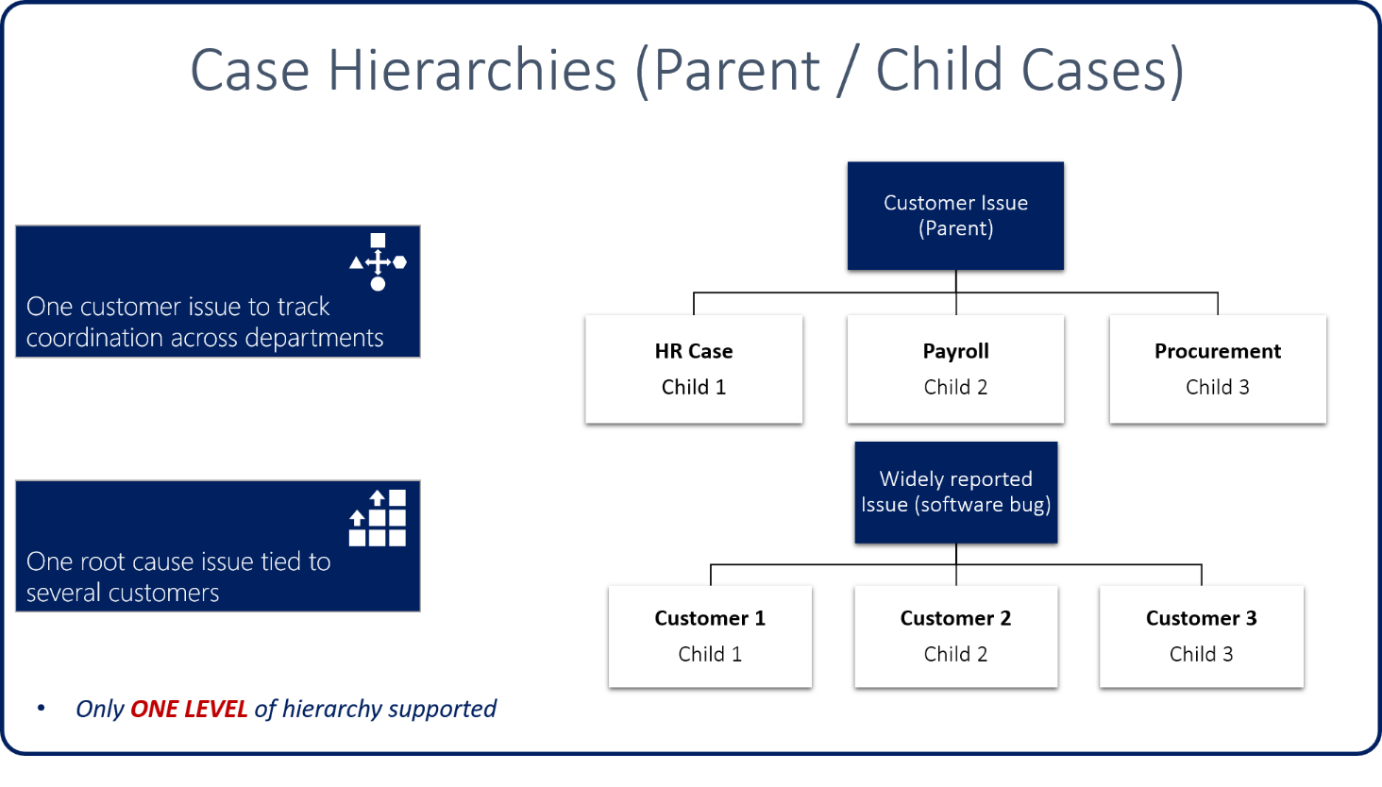
Case hierarchies
Parent / Child cases

Slide 50
Case hierarchies
Cascading options
None: Closing the parent case has no effect on child cases. Child cases must be closed individually
Close all child cases when parent is closed: Any open child cases are automatically closed when the parent case is closed.
Don't allow parent case closure until all child cases are closed: All child cases must be closed before the parent case can be closed.

Slide 51
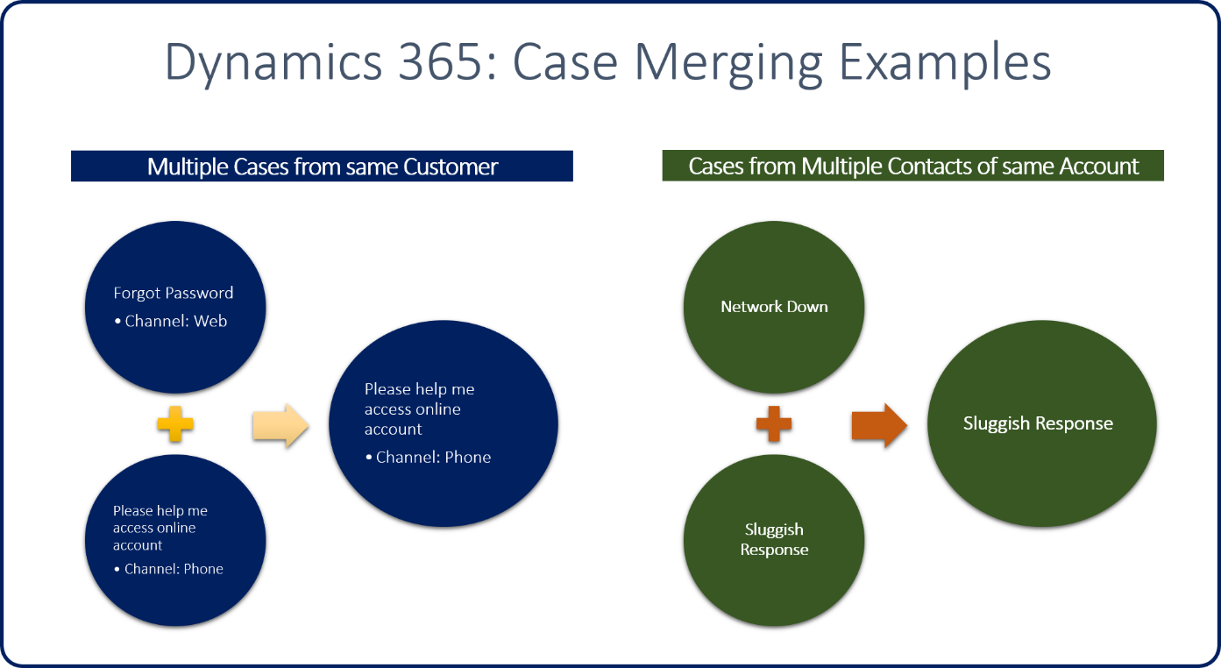
Case merging
Merge cases into a master case

Slide 52
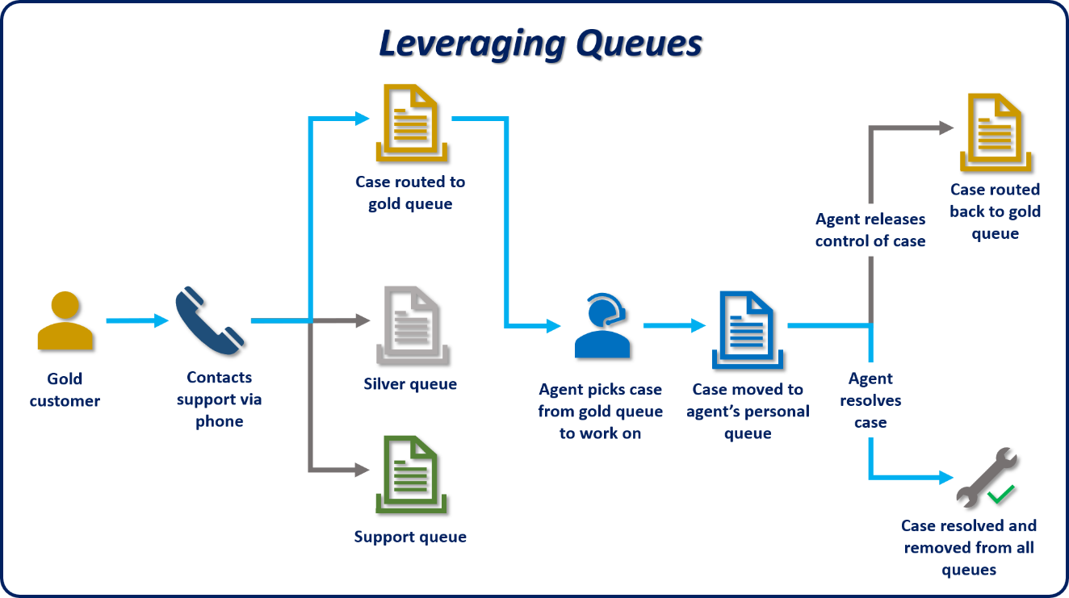
Queues
Using queues in Customer Service

Slide 53
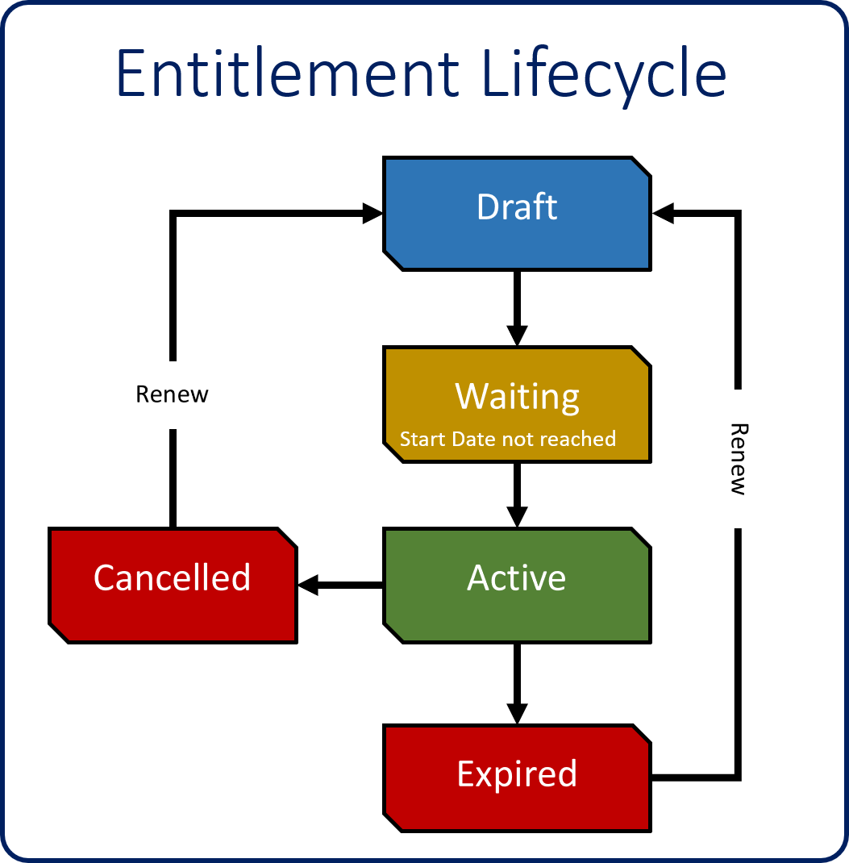
Entitlements
Lifecycle

Slide 54
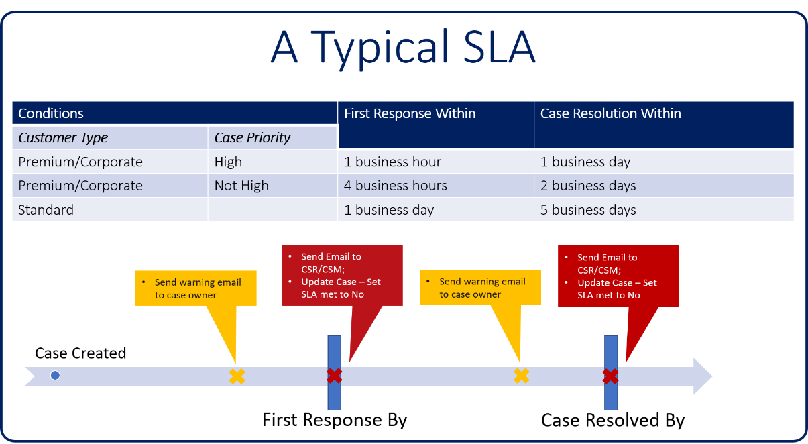
Service Level Agreements
Service Level Agreements (SLAs): Allow organizations to track against common Key Performance Indicators (KPIs)
KPIs available for Case:
First Response By
Resolve By

Slide 55
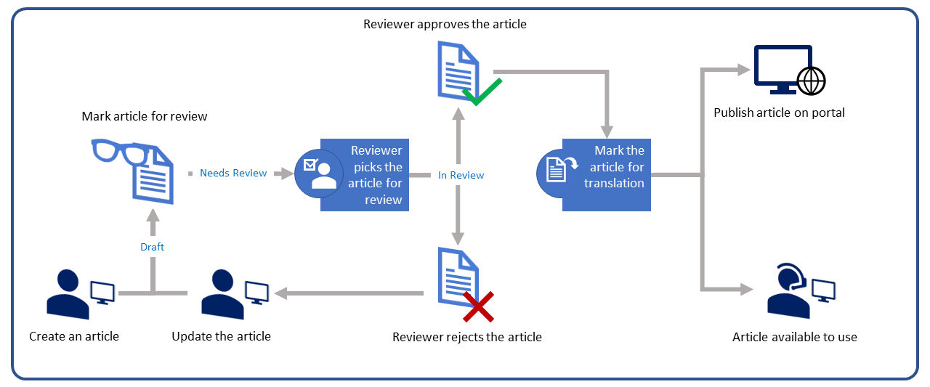
Knowledge management
Knowledge article lifecycle

Slide 56
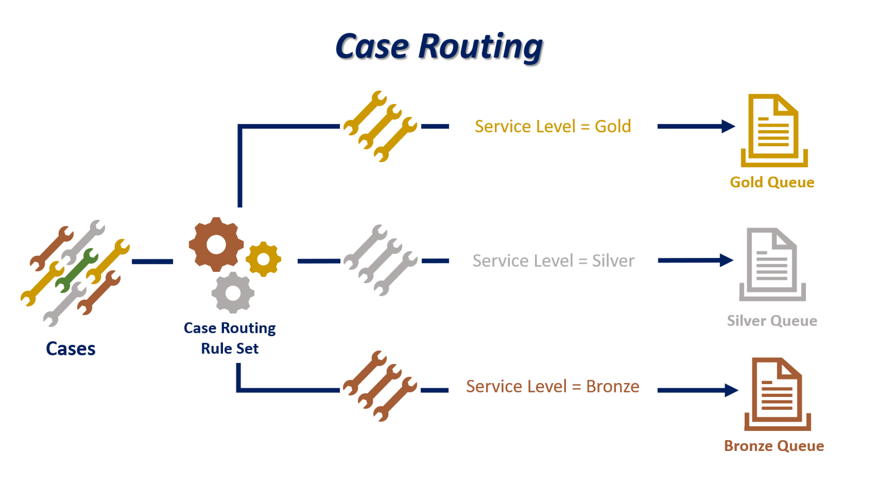
Basic routing

Slide 57
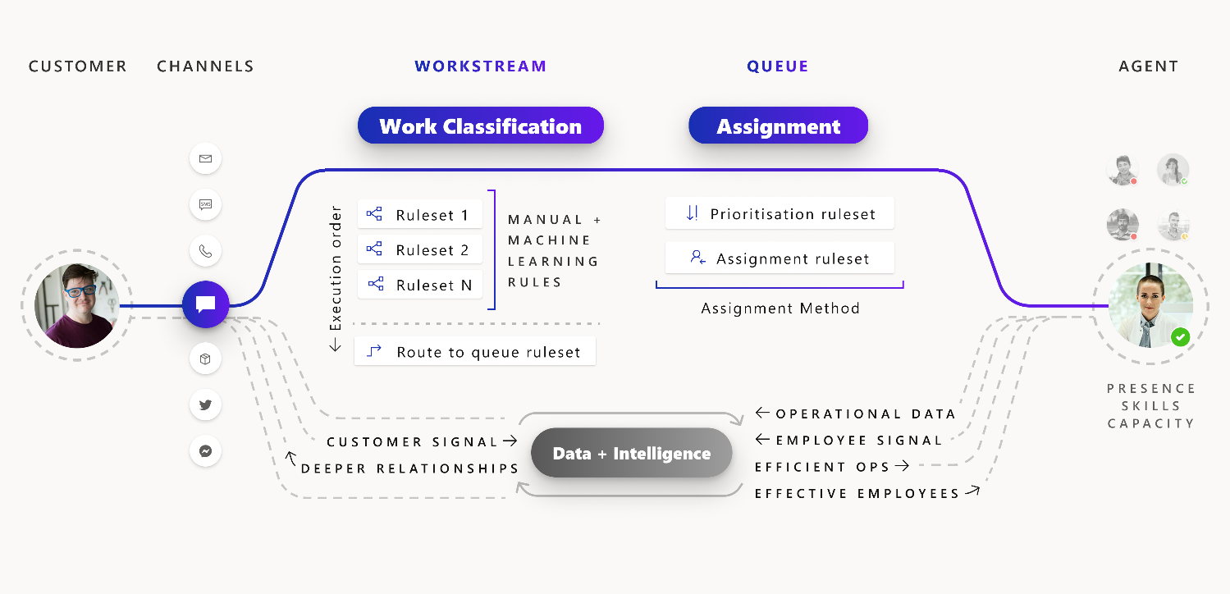
Unified Routing

Slide 58
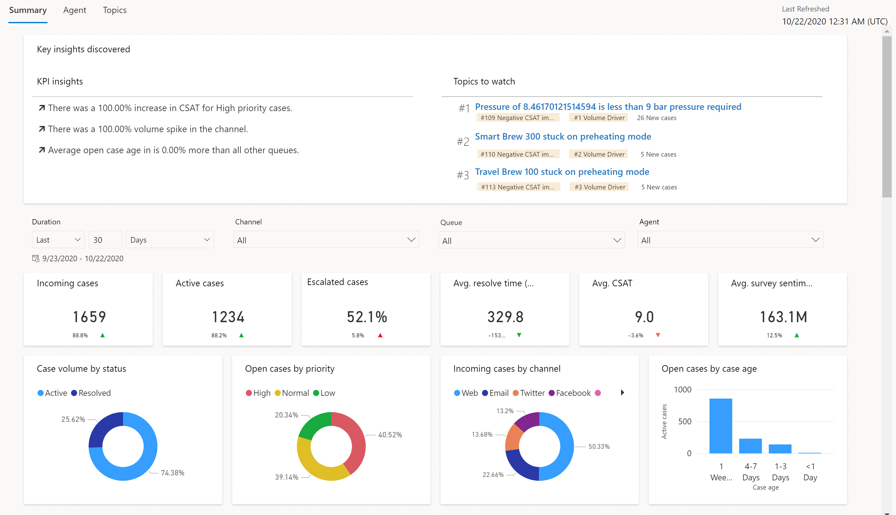
Customer Service historical analytics dashboard
Summary

Slide 59
Microsoft Dynamics 365 Field Service

Slide 60
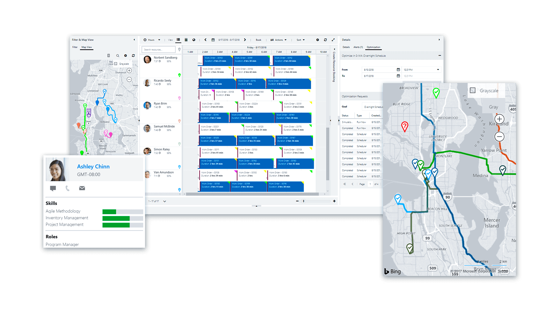
Dynamics 365 Field Service
Deliver service at customer locations
Complete more service calls per technician per week
Reduce travel time, mileage, and vehicle wear and tear
Improve first-time fix rate
Keep customers updated

Slide 61
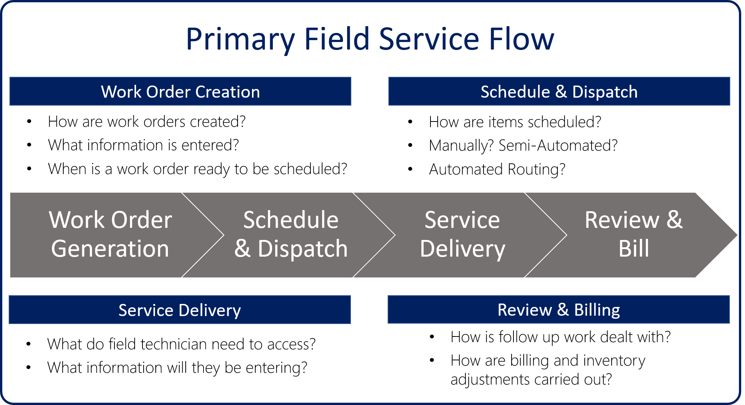
Dynamics 365 Field Service

Slide 62
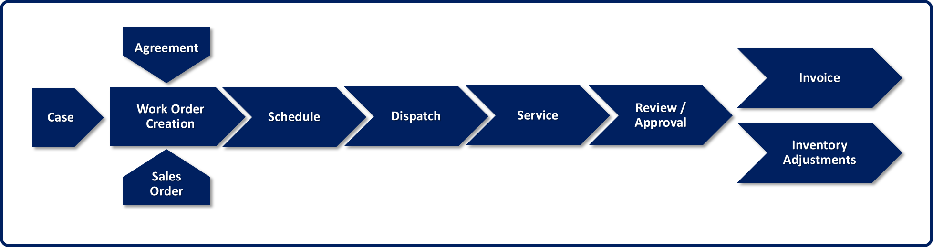
Work order lifecycle

Slide 63
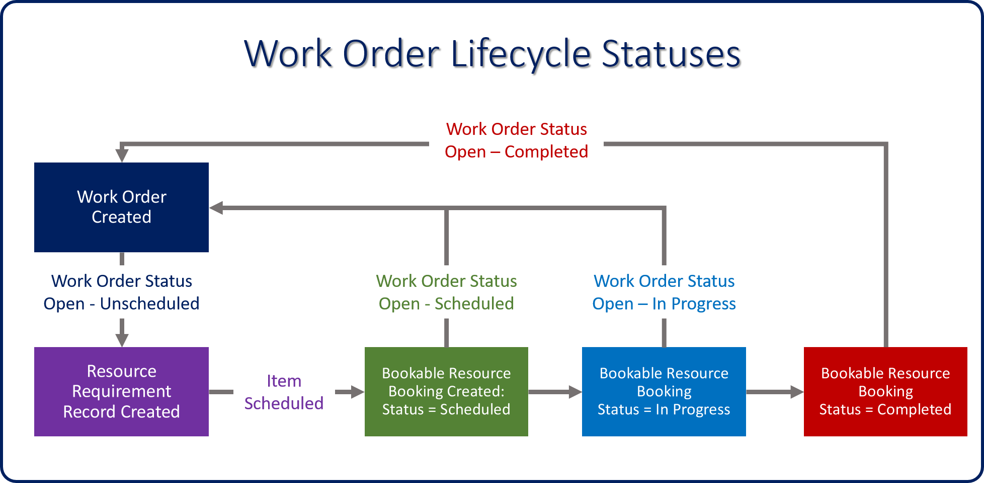
Work order lifecycle statuses

Slide 64
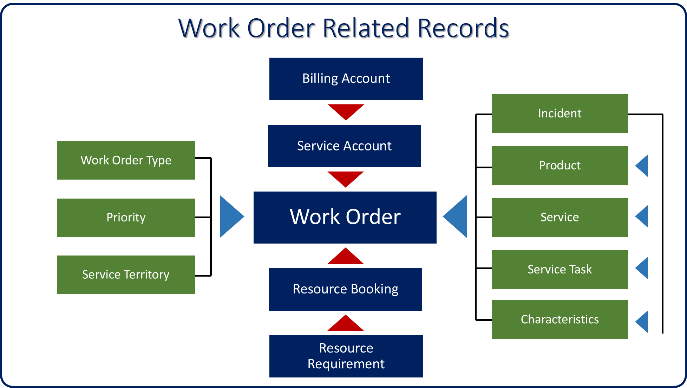
Work order

Slide 65
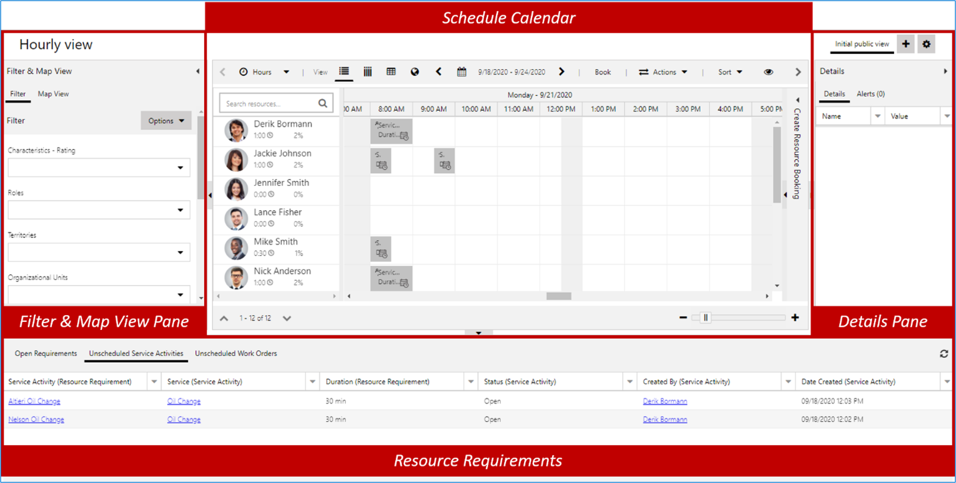
Schedule Board

Slide 66
Q & A

